Slide 1

Predicting Loan Defaults in Clients
Presented by: Sahar Khan, Gangadhar Sallagundla Chowdary, Irene Qiu

Slide 2

Executive Summary
Neural Network gives most accurate prediction (82.1%)
Important Indictors of Loan defaults:
Demographic information (gender, age segmentation)
Past payment history
Credit Limit
Education
Recommendations: Set Client requirements, Adjust rates for high-risk clients, and send frequent loan alerts.
Notes:
Past payment history overall was the highest indicator of loan defaults.
Of clients who default, 56.68% are women
Age range 25-30 years old make up the highest loan defaults.
Females are the most common sex with majority defaults
University students default the most, followed by graduate students.
Recommendations: set client requirements, adjust rates for high-risk clients, and send frequent loan alerts.

Slide 3

Data Processes
Objective: Predict Loan Defaults in Bank Customers
Cleaning and Manipulation:
Changed variables to appropriate data types(Numbers to Categorical variables)
Filtered for specific values or corrected values to be within range
Checked for outliers
Predicted loan defaults with 3 models
Notes:
Change variable type:For example, we used numbers are used to classifiy gender and education, those variables are converted into categorical variables
Filter values: in marriage column, marriage statauts should only include 1,2,3 to represent married, single, and others respectively, but the data set include 0,1,2,3. So we took out those wrong records with zeros

Slide 4

Best Performing Model : Neural Network
Appropriate model to use for understanding the relationship between inputs and outputs
Ability to predict that a client defaults next month (ROC Curve): 75.5%
Other Advantages:
Less Restriction on inputs
Ability to learn , model non-linear and complex relationships
Lower probability of Overfitting & Underfitting compared to KNN Model
Notes:
Based on ROC curve and Accuracy results (82.1%), we prefer Neural Network
Apart from evident results, few advantages of Neural Network over KNN are:
They are less restrictions on inputs
NN have better ability to learn , model non-linear and complex relationships
KNN results depends on optimal K. However, it increases the chances of overfitting as a small value of k could lead to overfitting as well as a big value of k can lead to underfitting.

Slide 5
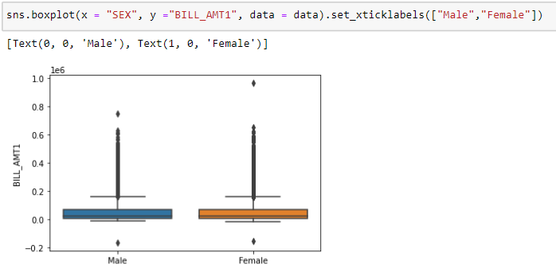
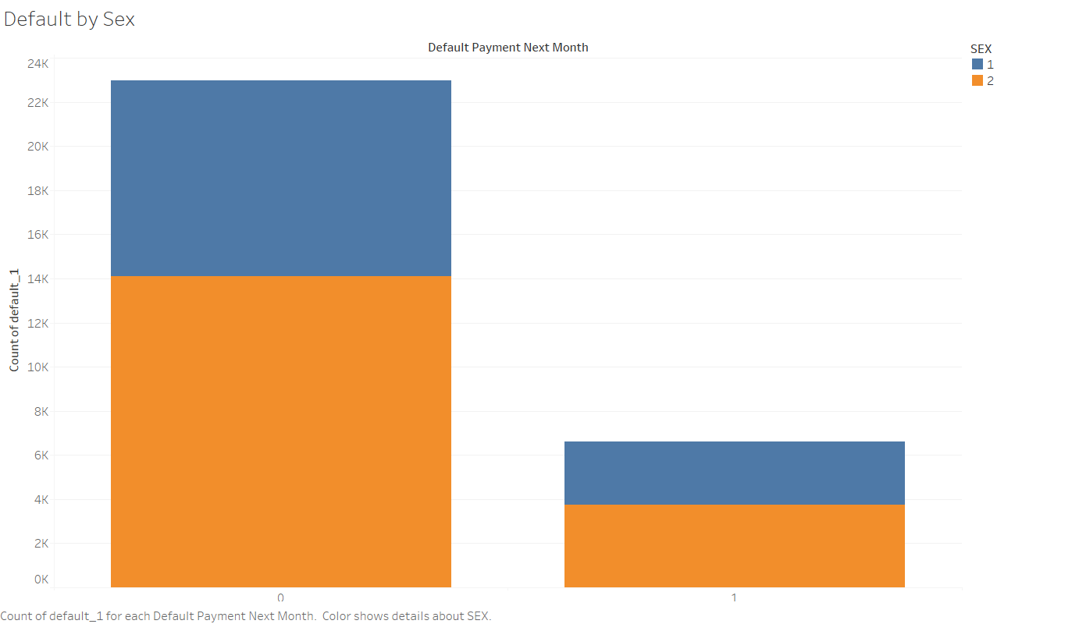
Most common sex that defaults the most
Female is the most common sex
Females are more likely to default on loans
Bill Amt is almost equal for Men and Women

Slide 6
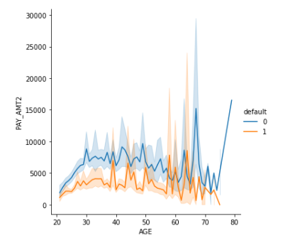
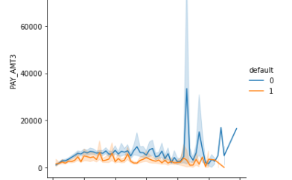
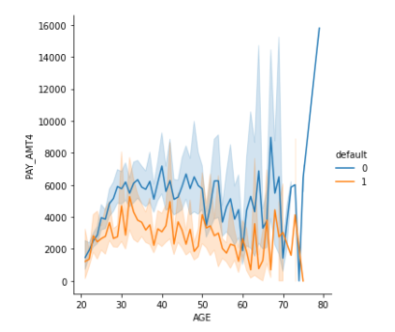
Relationship between Payment History and defaults
Higher repayment made by a client in the previous months, would lead to less defaults in the coming month
This relationship is true for all payment months.
Notes:
as we see a high in pay2 and low in pay3 and so on for next payments.
Higher the delay, the more likely
to default.
If a client paid a higher amount
last month, they are less likely to
default the next month. The
opposite is true, if they paid less
last month, they are likely to
default next month.

Slide 7
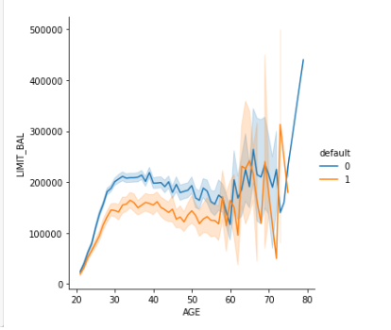
Relationship between Credit Limit and Defaults
Clients from Age 31 -55 who have a decent credit limit and are less likely to default.
These clients (working class) are already scrutinized by the bank for credit history and the ability to pay back.
Notes:
as we see a high in pay2 and low in pay3 and so on for next payments.
Higher the delay, the more likely
to default.
If a client paid a higher amount
last month, they are less likely to
default the next month. The
opposite is true, if they paid less
last month, they are likely to
default next month.

Slide 8
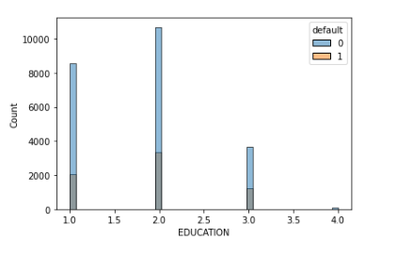
Relationship between Education and Defaults
University going students have higher default , followed by graduate student
Rising Education level associates with increase in tuition costs for graduate and university students make loan defaults difficult to manage
Notes:
as we see a high in pay2 and low in pay3 and so on for next payments.
Higher the delay, the more likely
to default.
If a client paid a higher amount
last month, they are less likely to
default the next month. The
opposite is true, if they paid less
last month, they are likely to
default next month.

Slide 9
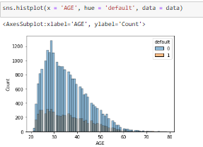
Relationship between Age and Defaults
The Age of customers is distributed between age 21 to 75.
Ages 23-30 have the highest count of defaults.
Notes:
as we see a high in pay2 and low in pay3 and so on for next payments.
Higher the delay, the more likely
to default.
If a client paid a higher amount
last month, they are less likely to
default the next month. The
opposite is true, if they paid less
last month, they are likely to
default next month.

Slide 10

Organizational Impact
Understanding common demographics associated with loan defaults will improve decision-making and save resources.
Strong attention towards a client’s past payment history will help prevent as many loan defaults.
If clients are reminded more often of deadlines and assistance, they should be more prepared to handle their loans.
Notes:
NATIONAL BUREAU OF ECONOMIC RESEARCH _ 2011
Interestingly the SMS reminders which is almost costless for the bank to implement has effected on late payments where a 25% reduction of late monthly payments had been observed. In addition we see some heterogeneity in the SMS impact, in particular less experienced borrowers and those with smaller loans respond more strongly to SMS, leading to clearing out payments and eventually entire loans.

Slide 11

Recommendation
Set a requirement for good history of past payments in clients before able to take out a loan
Set higher interest rates with longer payment periods for high-risk clients
Send additional alerts and assistance resources to clients during September (high correlation to default)
Notes:
After Analyzing various attributes to best determine the likelihood that a client defaults on a loan, a few set of Recommendations we suggest are as follows:

Slide 12
Summary
Use Neural Network Model for best accuracy
Variable Relationship with Default : Females likely default, Strong relationship between payments and defaults
The Bank can use different segments to aid in determining their loan process through Credit Limit, Education and Age segmentation
Notes:
1. To summarize what me, sahar and irene talked about and to conclude, we are going to be using the neural network model due to its high accuracy rate as the our model selection was based on accuracy.
2. Furthermore, we understand that a few relationships are much stronger to default than other relationships, for, example female loan takers are more likely to default, similarly a strong relationship is seen between payments and defaults as well.
3. Which brings me to my final point, the bank should be scrutinizing their loan process by embedding factors like age, credit limit, and level of education as they would speak a lot about the proboblity of default. Additionally the banks should also pay attention to the generalized realities provided by the model while giving out loans to their clients. This attention to detail could be a huge game changer for the bank by limiting the number of defaulters.

Slide 13

Thank You!

Slide 14
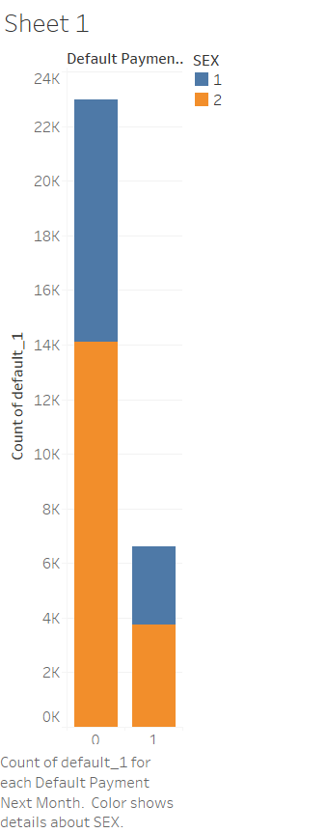
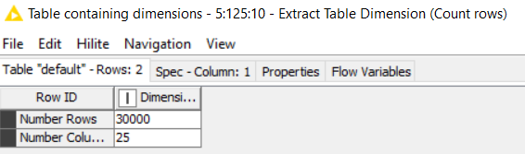
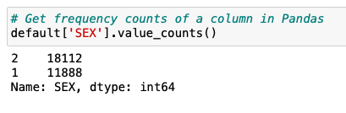
Appendix
Q1.1 How many customers are in the sample?
Q1.3 Which sex has the most defaults?
Female are more likely to default
Q1.2 What is the most common sex in the sample?
Females are the most common sex with majority defaults
Notes:
SEX value is different from mine

Slide 15
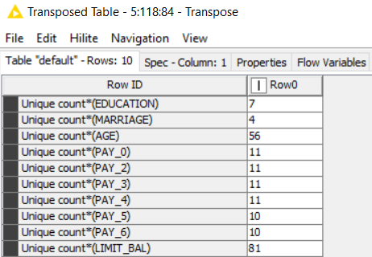
Q1.4 How many distinct values does marriage take on?
Marriage has 4 unique values
Notes:
Marriage has 4 values (0,1,2,3) but 0s are not legit. Removed 0s
Can also talk about how did you cleaned the education data ?

Slide 16
Q2.1 How is Bill_Amt1 distributed by sex?
Looks almost equal between Men and women
Q2.2 Does there appear to be any relationship between default and AGE?
The Age of customers is distributed between age 21 to 75.
Ages 23-30 have the highest count of defaults.

Slide 17
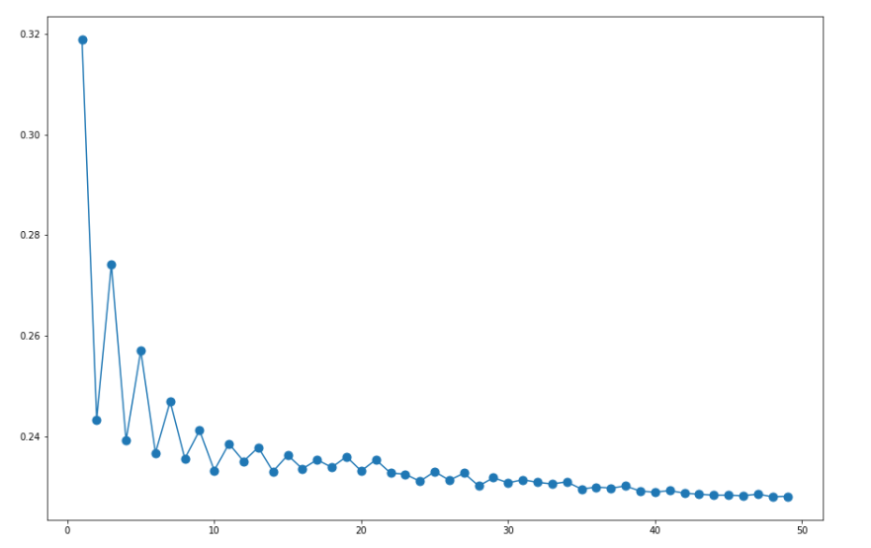
Q3.1 Build a model of default using kNN. Randomly partition the data into a training set (70%) and a validation set (30%). What value of k did you decide to use and why?
We decide to use k=30 since from the calculated error rate, at 30, the graph smoothens

Slide 18
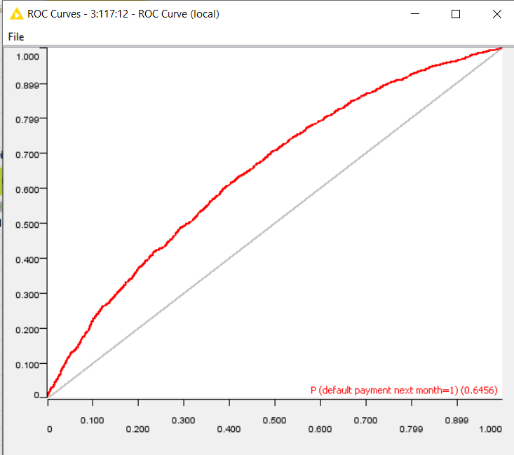
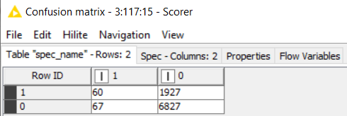
Q3.2 Score the validation data (predict) using the model. Produce a confusion table and an ROC for the scored validation data.

Slide 19
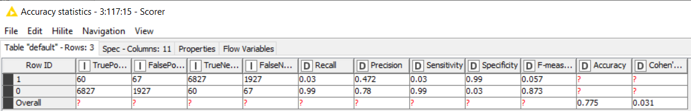
Q3.3 From the confusion table calculate the following metrics: accuracy, misclassification rate, true positive rate, false positive rate, specificity, precision, and prevalence.
Accuracy is 77.5

Slide 20
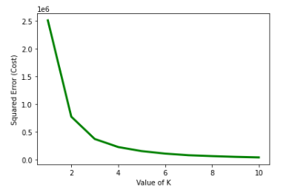
Q3.4 Use k-means clustering to segment the customers on AGE. What value of k did you decide to use and why?
K=4 is optimal for k-means clustering to segment the customers on Age
The calculated squared error on cost function shows the error curve smooths after k=4

Slide 21
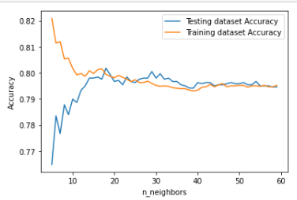
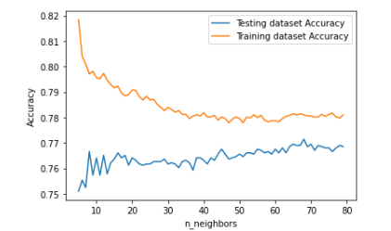
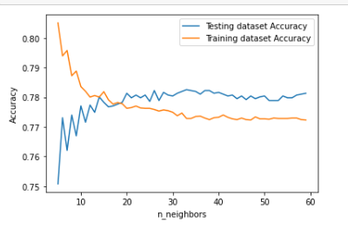
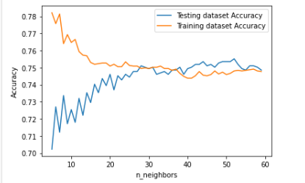
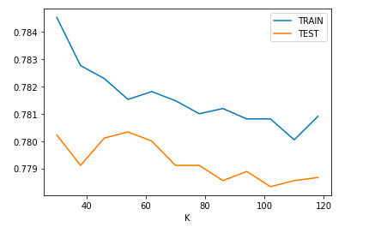
Q3.5 Build a model of default using kNN for each segment. Randomly partition the data into a training set (70%) and a validation set (30%) for each segment. What value of k did you decide to use and why?
We know that low value of k can result into noise misleading the prediction and higher values of k are expensive in terms of computation
k should be in [1, 144.91]. To make the model runs efficiently, we cut the range to [30, 120] and assign a step of 8 since too small a k will easily be affected by random noise and too large a k will include samples from other groups. Test is performance to see which k will result the best performance.
From the resulting graph, when k=54, the performance of the test set and train set is the most similar. As a result, we selected 54 as k number
Notes:
segment 0: mid-20 group, k = 14
segment 1: mid-40 group, k = 42
segment 2: mid-30 group, k = 50
segment 3: mid-50 group, k = 20

Slide 22
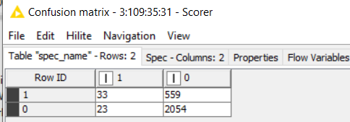
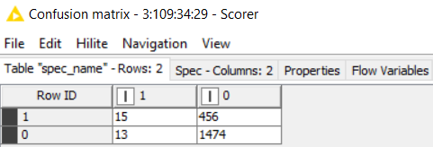
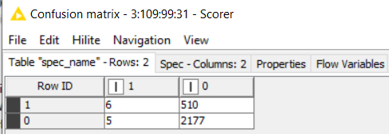
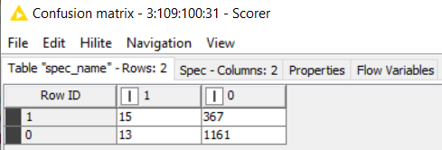
Q3.6 Score the validation data (predict) using the models. Produce a confusion table for the scored validation data for each segment. How do they compare?
Cluster 0
Cluster 1
Cluster 2
Cluster 3

Slide 23
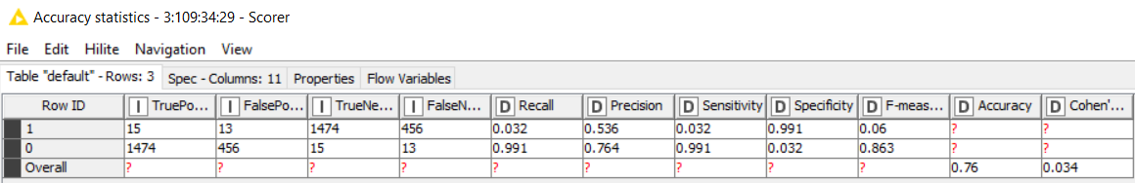
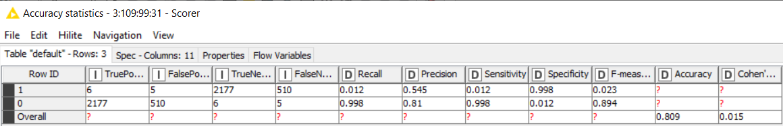
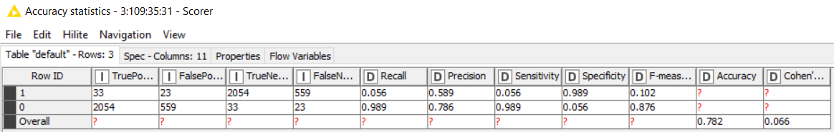

Q3.7 From the confusion tables for each segment calculate the following metrics: accuracy, misclassification rate, true positive rate, false positive rate, specificity, precision, and prevalence. How do they compare?

Slide 24
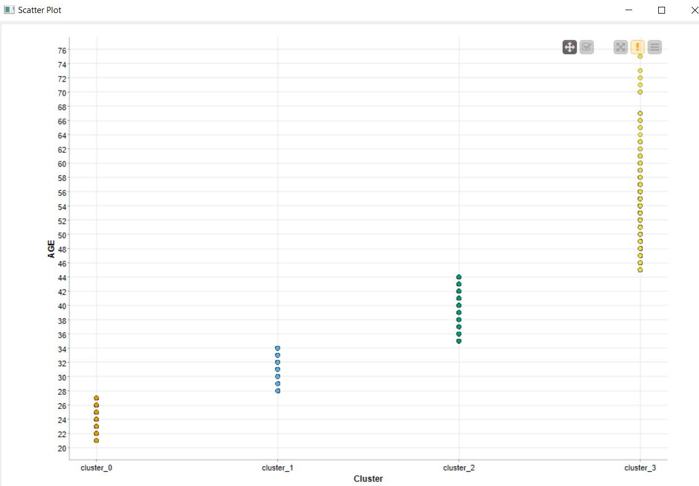
4 Cluster segmented with Age
Cluster 0 : Age 21-27
Cluster 1 : Age 28-34
Cluster 2 : Age 35-44
Cluster 3 : Age 45-75

Slide 25
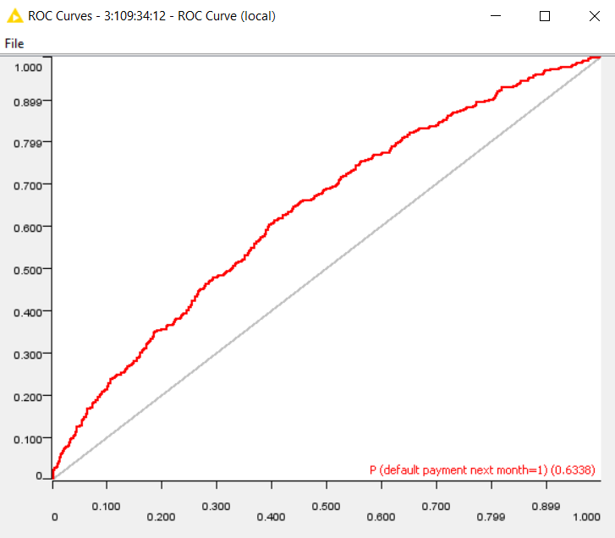
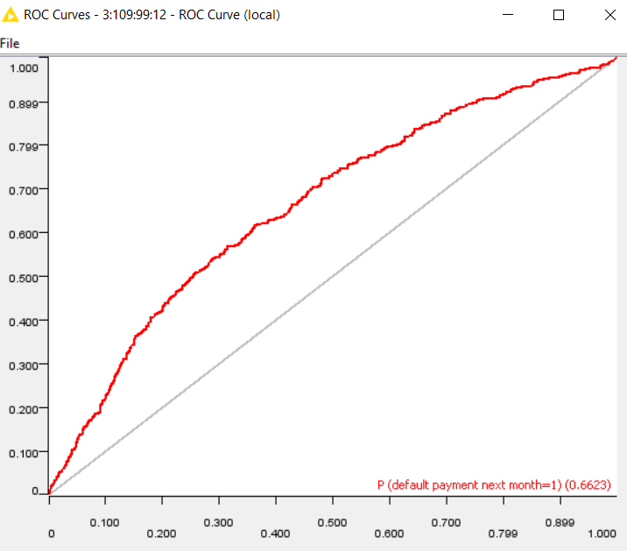
Q3.8 Produce an ROC curve for each AGE segment and report the AUCs.

Slide 26
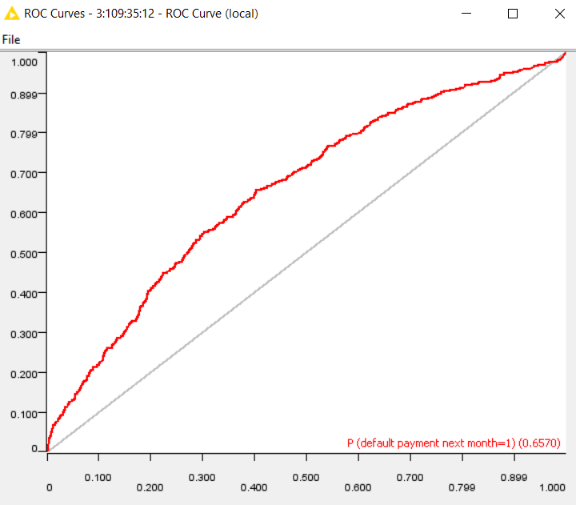
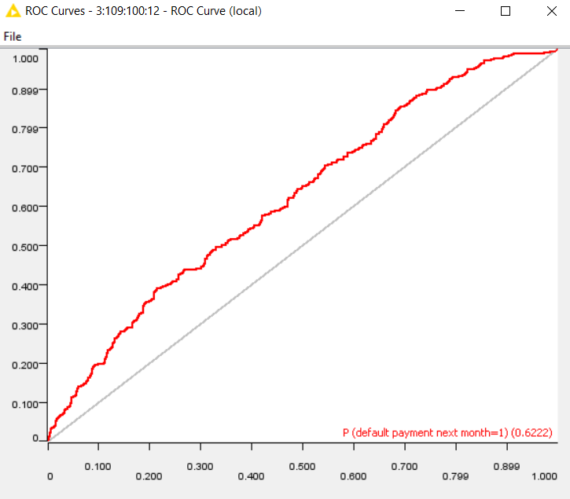

Slide 27
Q3.9 Do any of the models built on the AGE segments have a better classification performance than the non-segmented population model? How much better or worse?
Non-Segmented Model Accuracy:
KNN: 77.5%
NN: 82.1%
Age Clustered KNNs:76%, 80.9%,78.2%,75.6%
Mean Accuracy of 4 clusters: 77.6%
Conclusion: Non-Segmented Models have better accuracy than Model Built on Age Segments

Slide 28
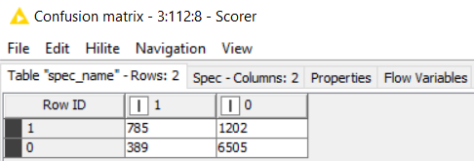
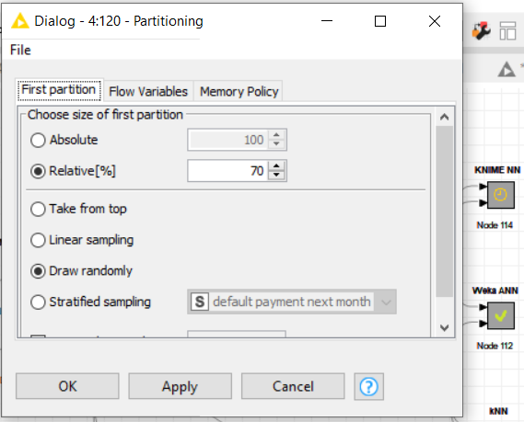
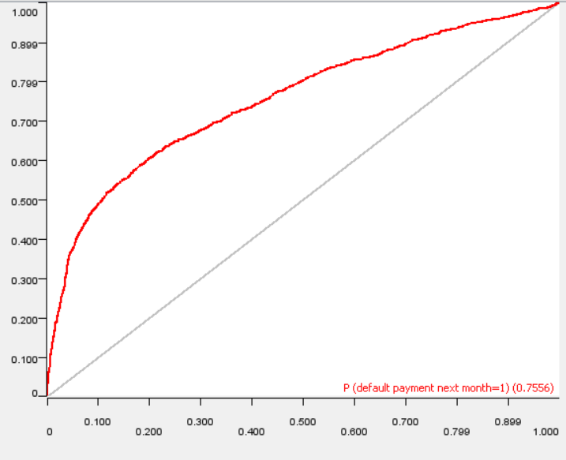
Neutral Network
Q4.2 Score the validation data (predict) using the model. Produce a confusion table and an ROC for the scored validation data.
Q4.1 Build a model of default using ANN. Randomly partition the data into a training set (70%) and a validation set (30%).

Slide 29
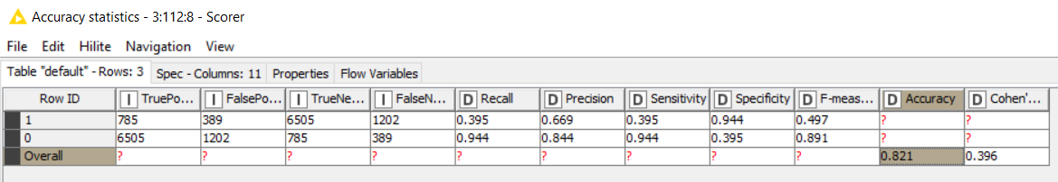
Q4.3 From the confusion table calculate the following metrics: accuracy,
misclassification rate, true positive rate, false positive rate, specificity, precision, and prevalence.
Accuracy Score of NN: 82.1

Slide 30
Q5.1 Of the three models, which do you prefer to use and why?
Based on ROC curve and Accuracy results, we prefer Neural Network
Apart from evident results, few advantages of Neural Network over KNN are:
They are less restrictions on inputs
NN have better ability to learn , model non-linear and complex relationships
KNN results depends on optimal K. However, it increases the chances of overfitting as a small value of k could lead to overfitting as well as a big value of k can lead to underfitting.

